Slide 1
Cultural Geography
Geog 360 Human Geography
Dr. Jocoy

Slide 2
Learning objectives
Identify the characteristics of cultural geographic studies
Define culture, cultural landscape, placelessness, and in-place and out-of-place.
Identify human geographic concepts of importance in Fletchall’s 2016 article

Slide 3
1. Cultural Geographic Studies
Analyze & interpret the spatiality of culture
Explain the spatial patterns of cultural traits
Illustrate how humans create places through culture
Logic: Human geography is the study of the spatial organization of human activity and of people’s relationship to their environment. If studying culture, a human geographer would take an approach that emphasizes the location of culture and how culture develops in specific places.

Slide 4
2. Defining concepts
Culture - Social creations consisting of shared beliefs and practices that are dynamic.
Material culture – tangible and visible artifacts, implements, structures created by people – ex’s: clothing, hair styles
Non-material culture – oral traditions and behavioral practices – ex’s: songs, stories

Slide 5
2. Concepts cont.
Cultural Landscape – human modification of the surface of the earth to meet economic, political, and cultural needs (Carl Sauer)
Sense of place – emotional attachments people develop with specific localities; a component of collective identity of cultural groups (Yi Fu Tuan)
Place/Placelessness (Ted Relph)
Place – locations with meaning
Placelessness – location empty of meaning, lacking uniqueness or sense of place
ex: Geography of Nowhere (James Howard Kunstler)
Critique of auto-dependent suburbia for its lack of a distinctive sense of place and community civic life

Slide 6
2. Concepts cont.
In-place/Out-of-place (Tim Cresswell)
Sense of belonging or not belonging in a place
Exclusion or Inclusion in a geographic location or spatial arrangement
Concepts of social mix & segregation (August et al 2017 opinion in The Vancouver Sun)

Slide 7
3. Concept from Fletchall’s cultural geography research
Neolocalism (Wes Flack)
seeking out of local knowledge & attachment to a place to experience a feeling of connection with a unique culture
Place-making
actively constructing material and non-material culture associated with a location
Creating meaningful experiences in and of place

Slide 8
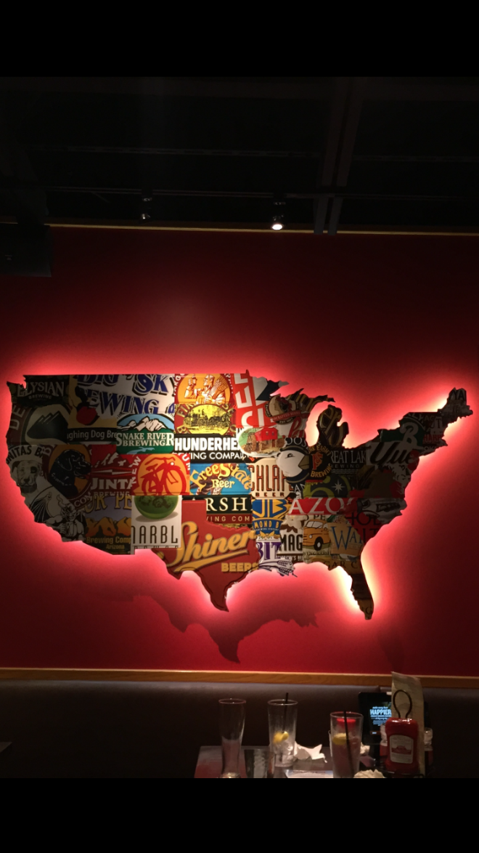
From a Red Robin restaurant (Provided by a former Geog 360 student in Sept 2015)

Slide 9
What makes Fletchell’s article a Human Geographic study?
What makes it cultural geography?
Notes:
If out of time put up answers on the white board.

Slide 10
Cultural Geogrpahy CR-1 Small Group Discussion
Huizinga, R.P. & B. van Hoven. (2018) Everyday Geographies of Belonging: Syrian refugee experiences in the Northern Netherlands, Geoforum 96: 309-317.

Slide 11
Geoforum Journal
Webpage
https://www.journals.elsevier.com/geoforum
Review to understand the subject matter published in this journal.

Slide 12
Concepts in Huizinga, R.P. & B. van Hoven 2018
Belonging – spatial inclusion & exclusion
Place-belongingness or Sense of home p310
Transnational sense of belonging p311
Geographies of encounter
Encounter hypothesis – increase familiarity & tolerance, changing attitudes toward cultural “others”
Intercultural encounters of refugees
Everyday encounters: where people interact
Transitory spaces (in-between, used to get from one place to another – sidewalks, waiting rooms, public transport)
Third spaces (outside home and work; public spaces)
“New place” of belonging – refugee’s home engages with everyday life in new place (Turkish supermarkets)

Slide 13
Implications of results
Spatial dispersal policy for refugees
Results challenge this method for integration
Suggest creating spaces for migrant transnationalism & belonging

Slide 14
Learning Objectives
distinguish between textbook writing and academic journal articles that publish research
describe and explain the necessary components of the research process
situate contextually and evaluate critically peer-reviewed scholarship in which human geographers address contemporary issues
Notes:
Bring in academic journals to class.

Slide 15
1. Empirical Research
Appears as articles within academic journals
Presents results of a research study that draws on collection & analysis of original data
Follows a structure for reporting on the research conducted by the author(s)

Slide 16
2. Structure of Empirical Research Articles
Introduction – includes thesis or argument
Research question/hypothesis to be answered
Literature review/Conceptual framework section– reviews previous studies that addressed your subject & thesis briefly
Data & methods – describes how data were collected and analyzed
Findings – presents evidence that answers research question
Discussion & implications – interprets the meaning of findings to advance theory & practice
Conclusion – restates what has been learned

Slide 17
3. Critical Review paper
Critical Review - summarizes and evaluates an individual academic research article
Peer review process –
Editors and 2-3 qualified experts (ie “peers”) review an empirical research article before it is approved by the editor for publication.
Double-blind review to ensure non-biased evaluation.
Evaluation of whether the study accomplishes its goals.
Does the author provide sufficient evidence to support his thesis (argument) convincingly? Why or why not?

